Slide 1


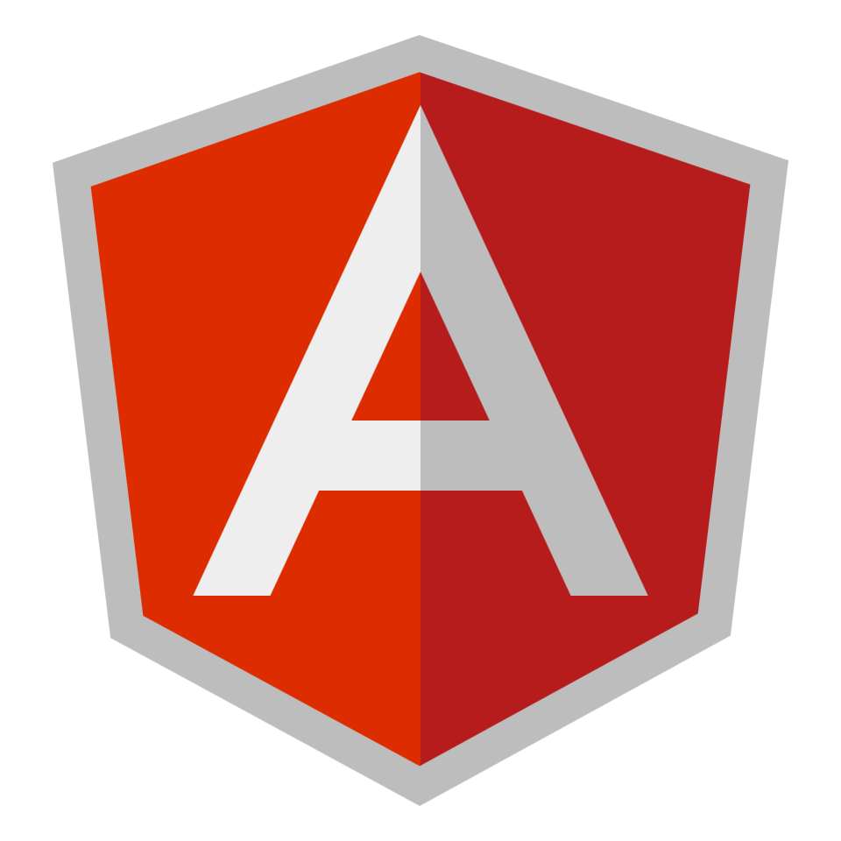
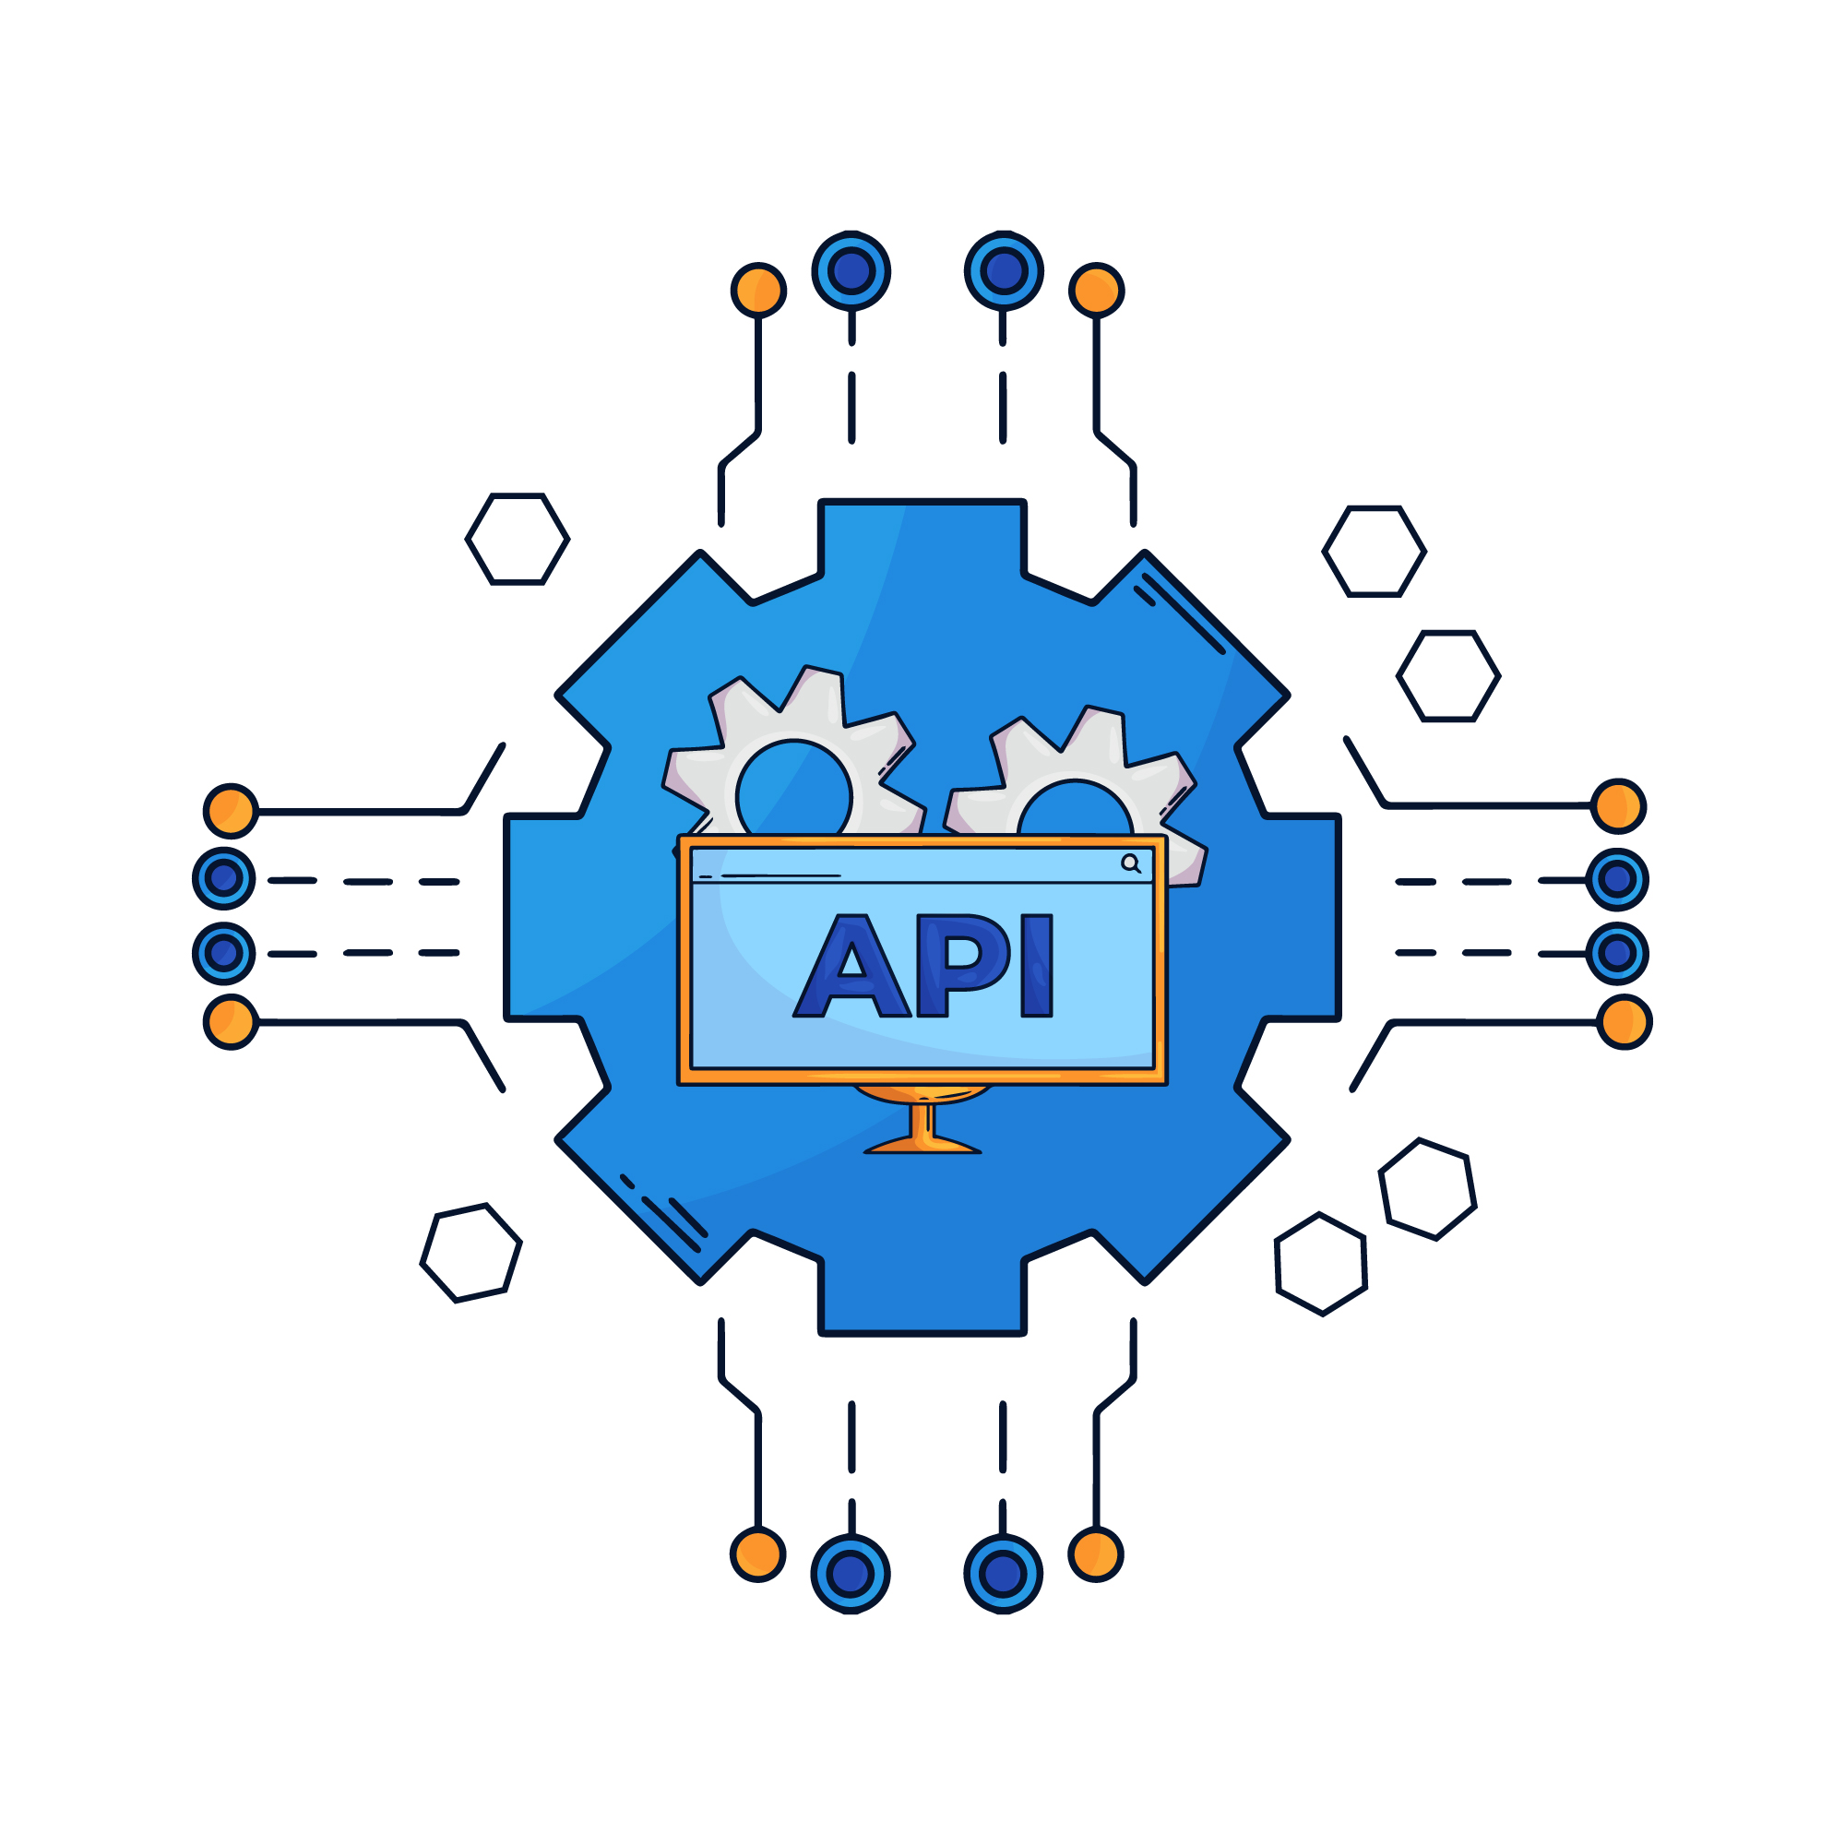
Introduction to Modern JavaScript (ES6+)

Slide 2
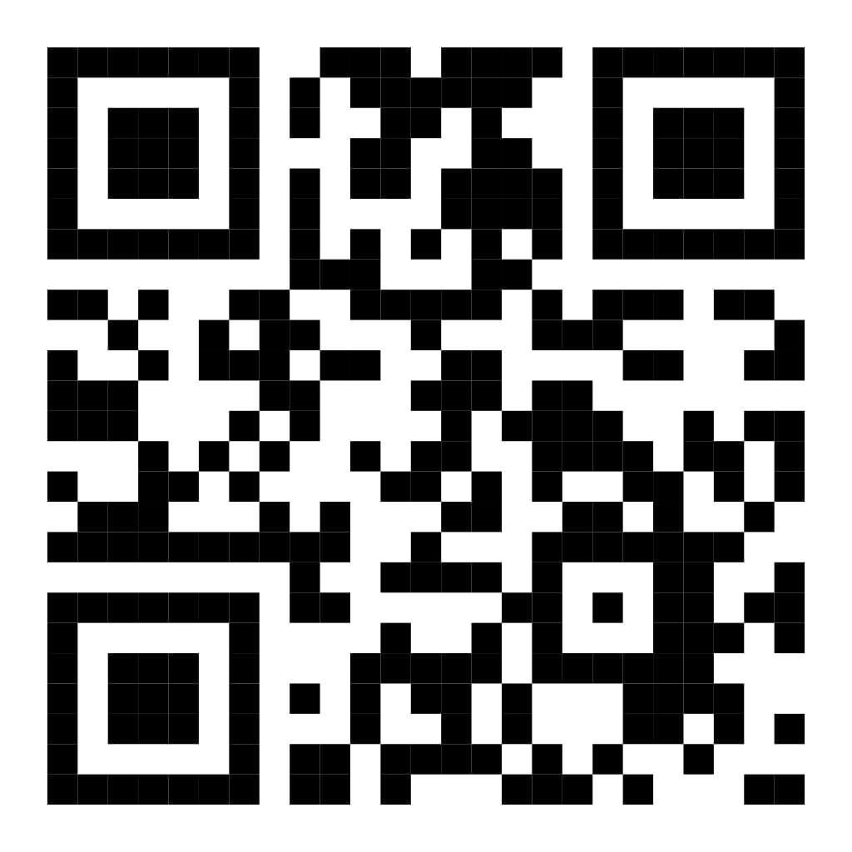
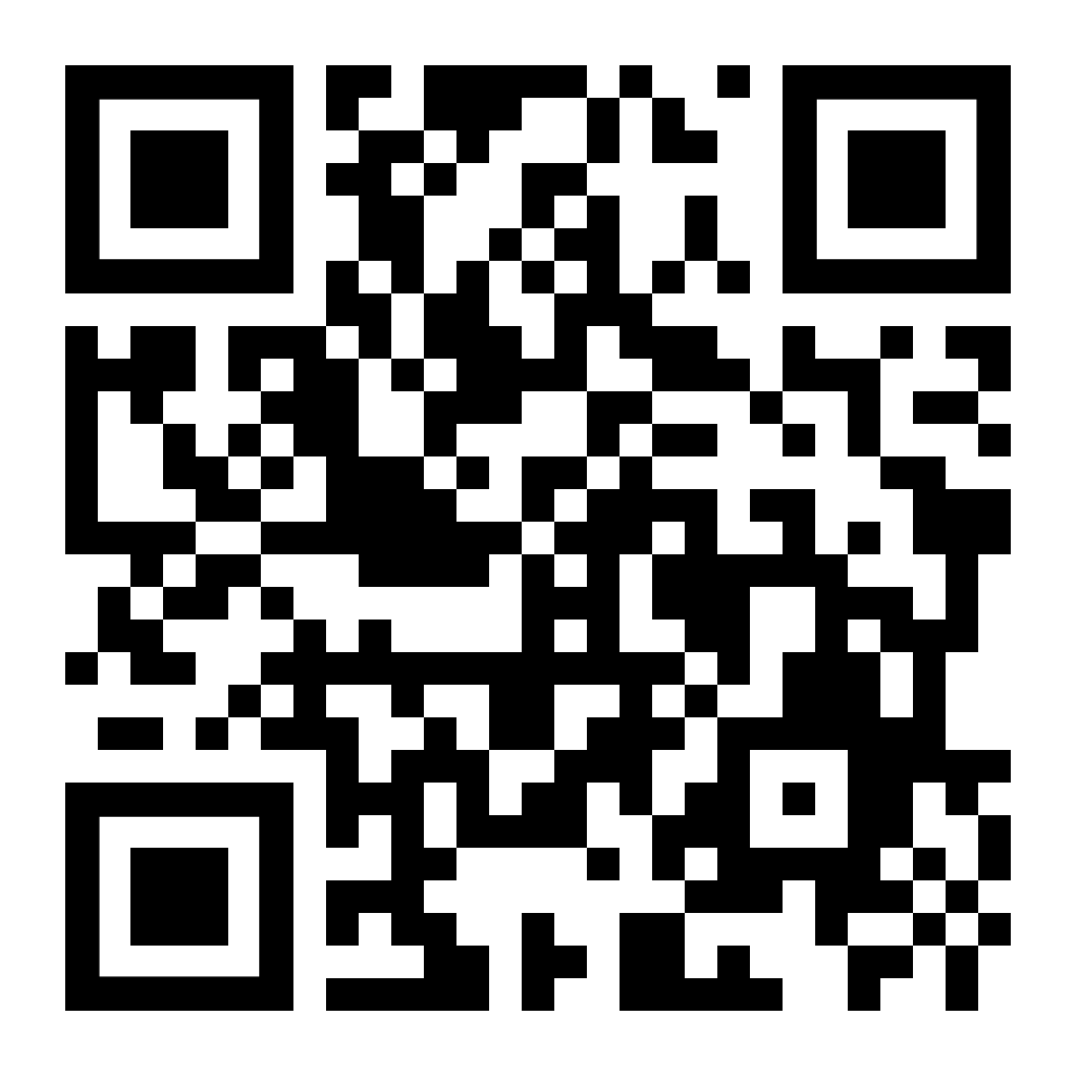
Instructors
Eng. Ahmed Mohamed Abu-Bakr
IC Layout engineer
Full stack web developer Laravel-react
Eng. Nada Harby Motawe
Computer science engineer
Full stack web developer

Slide 3
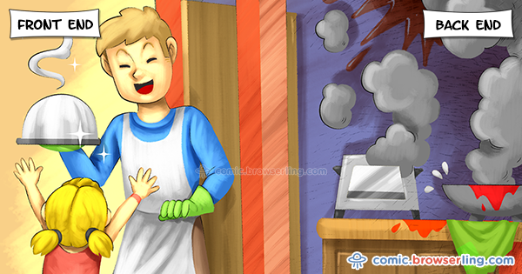

Slide 4
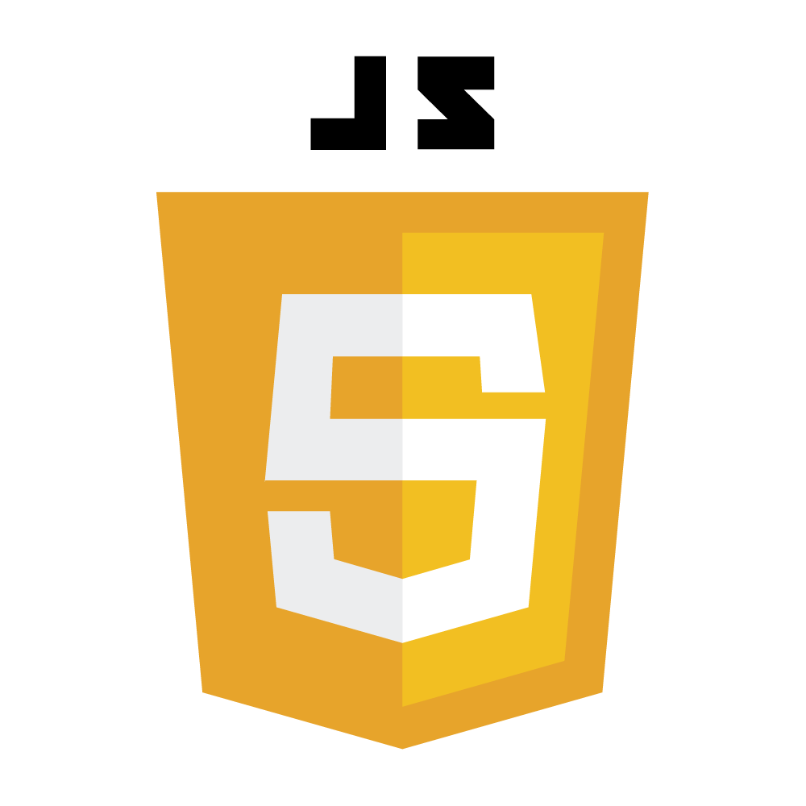
Day 7: Why Learn ES6+ Features
✅ الكود بيبقى أقصر وأنظف
✅ أسهل في القراءة والفهم للفرق الكبيرة
✅ بيسهّل التعامل مع بيانات ومشاريع معقّدة
✅ ضروري جدًا في كل التقنيات الحديثة زي
React, Node.js, Vue✅ بيقلل الأخطاء البرمجية بشكل كبير
Notes:
Syntax is crucial in programming for several reasons:
Clarity and Readability: Syntax provides a structured way to write code, making it easier for programmers to read and understand. Consistent syntax helps convey the intended logic and flow of the program.
Error Reduction: Strict syntax rules help catch errors early in the development process. If the syntax is incorrect, the compiler or interpreter will typically provide feedback, preventing the program from running until the issues are resolved.
Language Definition: Each programming language has its own syntax that defines how code is structured. This syntax is part of what distinguishes one language from another and defines how programmers interact with the language's features.
Tooling and Support: Many development tools, such as IDEs and linters, rely on the syntax of a programming language to provide features like code completion, syntax highlighting, and error detection. Changing the syntax could disrupt these tools' effectiveness.

Slide 5
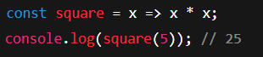
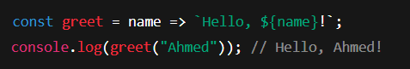
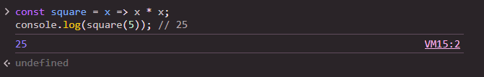
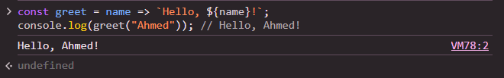
Day 7: Arrow Functions
Arrow Functions طريقة مختصرة لكتابة الدوال في جافاسكريبت، بتسهل الكود، وكمان بتحل مشاكل الـthis في بعض الحالات.
لو فيه سطر واحد بيرجع قيمة، تقدر تشيل الأقواس وreturn.
Notes:
Syntax is crucial in programming for several reasons:
Clarity and Readability: Syntax provides a structured way to write code, making it easier for programmers to read and understand. Consistent syntax helps convey the intended logic and flow of the program.
Error Reduction: Strict syntax rules help catch errors early in the development process. If the syntax is incorrect, the compiler or interpreter will typically provide feedback, preventing the program from running until the issues are resolved.
Language Definition: Each programming language has its own syntax that defines how code is structured. This syntax is part of what distinguishes one language from another and defines how programmers interact with the language's features.
Tooling and Support: Many development tools, such as IDEs and linters, rely on the syntax of a programming language to provide features like code completion, syntax highlighting, and error detection. Changing the syntax could disrupt these tools' effectiveness.

Slide 6
Day 7: Arrow Functions - Task
🧠 Arrow Functions - Task
❓ السؤال:
عايزك تكتب دالة باسم double باستخدام Arrow Function، الدالة تاخد رقم وترجع الرقم مضروب في 2، وكمان جرّب الدالة باستخدام console.log.
Notes:
Syntax is crucial in programming for several reasons:
Clarity and Readability: Syntax provides a structured way to write code, making it easier for programmers to read and understand. Consistent syntax helps convey the intended logic and flow of the program.
Error Reduction: Strict syntax rules help catch errors early in the development process. If the syntax is incorrect, the compiler or interpreter will typically provide feedback, preventing the program from running until the issues are resolved.
Language Definition: Each programming language has its own syntax that defines how code is structured. This syntax is part of what distinguishes one language from another and defines how programmers interact with the language's features.
Tooling and Support: Many development tools, such as IDEs and linters, rely on the syntax of a programming language to provide features like code completion, syntax highlighting, and error detection. Changing the syntax could disrupt these tools' effectiveness.

Slide 7
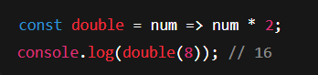
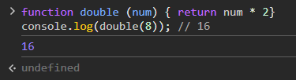
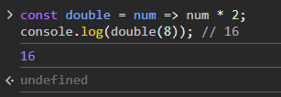
Day 7: Arrow Functions - Task
✅ Answer 1
Notes:
Syntax is crucial in programming for several reasons:
Clarity and Readability: Syntax provides a structured way to write code, making it easier for programmers to read and understand. Consistent syntax helps convey the intended logic and flow of the program.
Error Reduction: Strict syntax rules help catch errors early in the development process. If the syntax is incorrect, the compiler or interpreter will typically provide feedback, preventing the program from running until the issues are resolved.
Language Definition: Each programming language has its own syntax that defines how code is structured. This syntax is part of what distinguishes one language from another and defines how programmers interact with the language's features.
Tooling and Support: Many development tools, such as IDEs and linters, rely on the syntax of a programming language to provide features like code completion, syntax highlighting, and error detection. Changing the syntax could disrupt these tools' effectiveness.

Slide 8
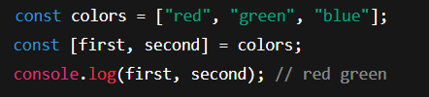
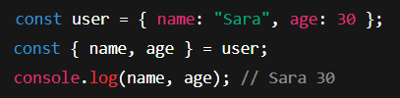
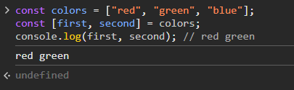
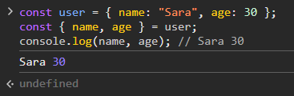
Day 7: Destructuring - Arrays & Objects
Destructuring طريقة حديثة لاستخراج القيم من الكائنات أو المصفوفات بشكل مباشر، من غير ما تحتاج تكتب كود طويل.
لو فيه سطر واحد بيرجع قيمة، تقدر تشيل الأقواس وreturn.
Notes:
Syntax is crucial in programming for several reasons:
Clarity and Readability: Syntax provides a structured way to write code, making it easier for programmers to read and understand. Consistent syntax helps convey the intended logic and flow of the program.
Error Reduction: Strict syntax rules help catch errors early in the development process. If the syntax is incorrect, the compiler or interpreter will typically provide feedback, preventing the program from running until the issues are resolved.
Language Definition: Each programming language has its own syntax that defines how code is structured. This syntax is part of what distinguishes one language from another and defines how programmers interact with the language's features.
Tooling and Support: Many development tools, such as IDEs and linters, rely on the syntax of a programming language to provide features like code completion, syntax highlighting, and error detection. Changing the syntax could disrupt these tools' effectiveness.

Slide 9
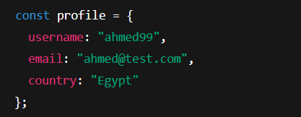
Day 7: Destructuring - Task
🧠 Destructuring - Task
❓ السؤال:
عندك الكود التالي، عايزك تستخدم Destructuring لاستخرج الـ username والـ email
Notes:
Syntax is crucial in programming for several reasons:
Clarity and Readability: Syntax provides a structured way to write code, making it easier for programmers to read and understand. Consistent syntax helps convey the intended logic and flow of the program.
Error Reduction: Strict syntax rules help catch errors early in the development process. If the syntax is incorrect, the compiler or interpreter will typically provide feedback, preventing the program from running until the issues are resolved.
Language Definition: Each programming language has its own syntax that defines how code is structured. This syntax is part of what distinguishes one language from another and defines how programmers interact with the language's features.
Tooling and Support: Many development tools, such as IDEs and linters, rely on the syntax of a programming language to provide features like code completion, syntax highlighting, and error detection. Changing the syntax could disrupt these tools' effectiveness.

Slide 10
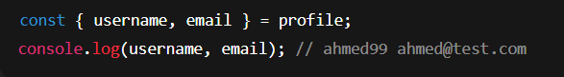
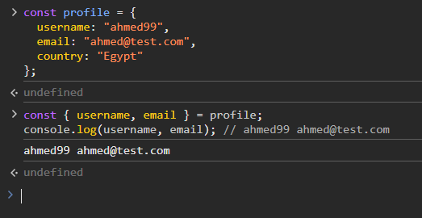
Day 7: Destructuring - Task
✅ Answer 2 – Destructuring - Task
Notes:
Syntax is crucial in programming for several reasons:
Clarity and Readability: Syntax provides a structured way to write code, making it easier for programmers to read and understand. Consistent syntax helps convey the intended logic and flow of the program.
Error Reduction: Strict syntax rules help catch errors early in the development process. If the syntax is incorrect, the compiler or interpreter will typically provide feedback, preventing the program from running until the issues are resolved.
Language Definition: Each programming language has its own syntax that defines how code is structured. This syntax is part of what distinguishes one language from another and defines how programmers interact with the language's features.
Tooling and Support: Many development tools, such as IDEs and linters, rely on the syntax of a programming language to provide features like code completion, syntax highlighting, and error detection. Changing the syntax could disrupt these tools' effectiveness.

Slide 11
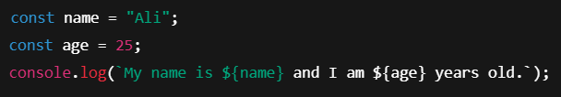
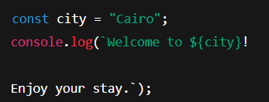
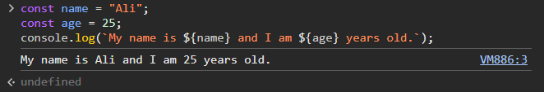
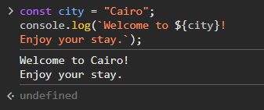
Day 7: Template Literals
Template Literals طريقة جديدة وأسهل لكتابة النصوص في جافاسكريبت، خصوصًا لو فيها متغيرات أو أكتر من سطر.
✅ بنستخدم العلامة `` بدل علامات التنصيص العادية
✅ بنقدر نحط متغيرات جوا النص باستخدام ${}
✅ بنقدر نكتب نص متعدد الأسطر بسهولة
Notes:
Syntax is crucial in programming for several reasons:
Clarity and Readability: Syntax provides a structured way to write code, making it easier for programmers to read and understand. Consistent syntax helps convey the intended logic and flow of the program.
Error Reduction: Strict syntax rules help catch errors early in the development process. If the syntax is incorrect, the compiler or interpreter will typically provide feedback, preventing the program from running until the issues are resolved.
Language Definition: Each programming language has its own syntax that defines how code is structured. This syntax is part of what distinguishes one language from another and defines how programmers interact with the language's features.
Tooling and Support: Many development tools, such as IDEs and linters, rely on the syntax of a programming language to provide features like code completion, syntax highlighting, and error detection. Changing the syntax could disrupt these tools' effectiveness.

Slide 12
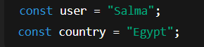
Day 7: Template Literals - Task
🧠 Template Literals - Task
❓ السؤال:
عندك المتغيرات التالية، عايزك تكتب رسالة ترحيب باستخدام Template Literals:
الناتج المطلوب يكون:
“Hello Salma, welcome from Egypt!”
Notes:
Syntax is crucial in programming for several reasons:
Clarity and Readability: Syntax provides a structured way to write code, making it easier for programmers to read and understand. Consistent syntax helps convey the intended logic and flow of the program.
Error Reduction: Strict syntax rules help catch errors early in the development process. If the syntax is incorrect, the compiler or interpreter will typically provide feedback, preventing the program from running until the issues are resolved.
Language Definition: Each programming language has its own syntax that defines how code is structured. This syntax is part of what distinguishes one language from another and defines how programmers interact with the language's features.
Tooling and Support: Many development tools, such as IDEs and linters, rely on the syntax of a programming language to provide features like code completion, syntax highlighting, and error detection. Changing the syntax could disrupt these tools' effectiveness.

Slide 13
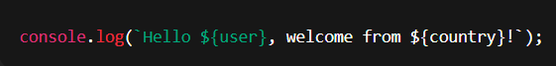
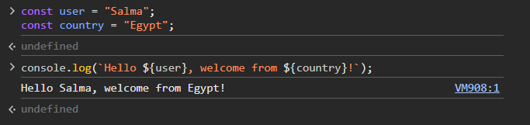
Day 7: Template Literals - Task
✅ Answer : Template Literals - Task
Notes:
Syntax is crucial in programming for several reasons:
Clarity and Readability: Syntax provides a structured way to write code, making it easier for programmers to read and understand. Consistent syntax helps convey the intended logic and flow of the program.
Error Reduction: Strict syntax rules help catch errors early in the development process. If the syntax is incorrect, the compiler or interpreter will typically provide feedback, preventing the program from running until the issues are resolved.
Language Definition: Each programming language has its own syntax that defines how code is structured. This syntax is part of what distinguishes one language from another and defines how programmers interact with the language's features.
Tooling and Support: Many development tools, such as IDEs and linters, rely on the syntax of a programming language to provide features like code completion, syntax highlighting, and error detection. Changing the syntax could disrupt these tools' effectiveness.

Slide 14
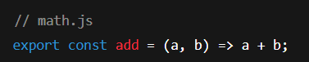
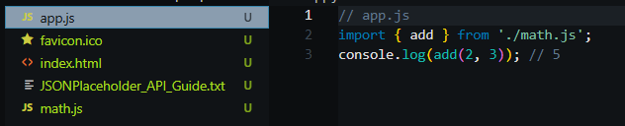
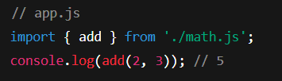
Day 7: Modern JavaScript Modules
الـ Modules بتقسّم الكود لملفات منفصلة عشان الكود يكون منظم وسهل التوسيع، وبنستخدم export و import لتبادل الأكواد بين الملفات.
✅ export: لتصدير دوال أو متغيرات أو كلاسات
✅ import: لاستيراد الحاجات دي في ملف تاني
Notes:
Syntax is crucial in programming for several reasons:
Clarity and Readability: Syntax provides a structured way to write code, making it easier for programmers to read and understand. Consistent syntax helps convey the intended logic and flow of the program.
Error Reduction: Strict syntax rules help catch errors early in the development process. If the syntax is incorrect, the compiler or interpreter will typically provide feedback, preventing the program from running until the issues are resolved.
Language Definition: Each programming language has its own syntax that defines how code is structured. This syntax is part of what distinguishes one language from another and defines how programmers interact with the language's features.
Tooling and Support: Many development tools, such as IDEs and linters, rely on the syntax of a programming language to provide features like code completion, syntax highlighting, and error detection. Changing the syntax could disrupt these tools' effectiveness.

Slide 15
Day 7: Modules - Task
🧠 Modules - Task
❓ السؤال:
عايزك تكتب ملف باسم utils.js فيه دالة باسم square ترجع مربع رقم، وفي ملفmain.js استورد الدالة واختبرها مع الرقم 4.
Notes:
Syntax is crucial in programming for several reasons:
Clarity and Readability: Syntax provides a structured way to write code, making it easier for programmers to read and understand. Consistent syntax helps convey the intended logic and flow of the program.
Error Reduction: Strict syntax rules help catch errors early in the development process. If the syntax is incorrect, the compiler or interpreter will typically provide feedback, preventing the program from running until the issues are resolved.
Language Definition: Each programming language has its own syntax that defines how code is structured. This syntax is part of what distinguishes one language from another and defines how programmers interact with the language's features.
Tooling and Support: Many development tools, such as IDEs and linters, rely on the syntax of a programming language to provide features like code completion, syntax highlighting, and error detection. Changing the syntax could disrupt these tools' effectiveness.

Slide 16
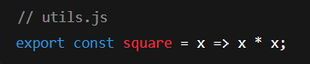
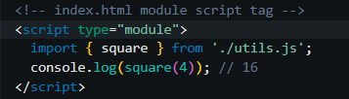
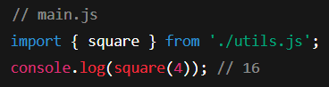
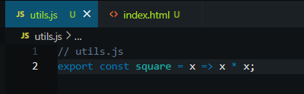
Day 7: Modules - Task
✅ Answer : Modules - Task
Notes:
Syntax is crucial in programming for several reasons:
Clarity and Readability: Syntax provides a structured way to write code, making it easier for programmers to read and understand. Consistent syntax helps convey the intended logic and flow of the program.
Error Reduction: Strict syntax rules help catch errors early in the development process. If the syntax is incorrect, the compiler or interpreter will typically provide feedback, preventing the program from running until the issues are resolved.
Language Definition: Each programming language has its own syntax that defines how code is structured. This syntax is part of what distinguishes one language from another and defines how programmers interact with the language's features.
Tooling and Support: Many development tools, such as IDEs and linters, rely on the syntax of a programming language to provide features like code completion, syntax highlighting, and error detection. Changing the syntax could disrupt these tools' effectiveness.

Slide 17
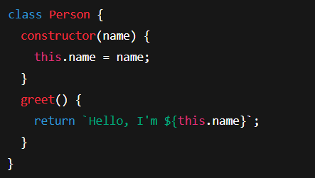
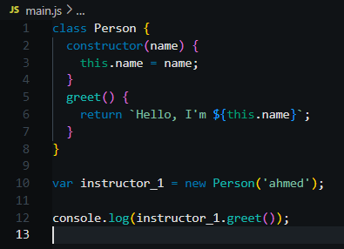
Day 7: Classes & Inheritance
الكلاسات بتنظّم الكود بأسلوب الكائنات OOP)) ، بتقدر تعمل كائنات بخصائص ودوال، وكمان تقدر تعمل وراثة بين الكلاسات.
Notes:
Syntax is crucial in programming for several reasons:
Clarity and Readability: Syntax provides a structured way to write code, making it easier for programmers to read and understand. Consistent syntax helps convey the intended logic and flow of the program.
Error Reduction: Strict syntax rules help catch errors early in the development process. If the syntax is incorrect, the compiler or interpreter will typically provide feedback, preventing the program from running until the issues are resolved.
Language Definition: Each programming language has its own syntax that defines how code is structured. This syntax is part of what distinguishes one language from another and defines how programmers interact with the language's features.
Tooling and Support: Many development tools, such as IDEs and linters, rely on the syntax of a programming language to provide features like code completion, syntax highlighting, and error detection. Changing the syntax could disrupt these tools' effectiveness.

Slide 18
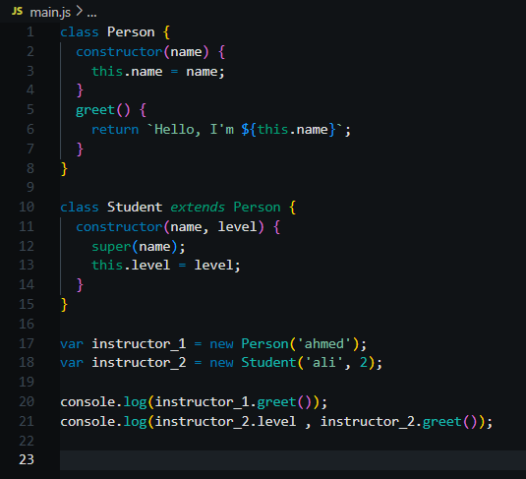
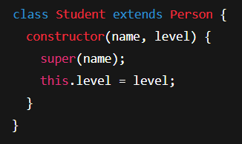
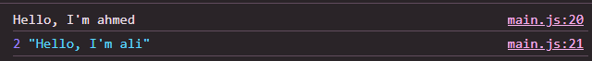
Day 7: Classes & Inheritance
Notes:
Syntax is crucial in programming for several reasons:
Clarity and Readability: Syntax provides a structured way to write code, making it easier for programmers to read and understand. Consistent syntax helps convey the intended logic and flow of the program.
Error Reduction: Strict syntax rules help catch errors early in the development process. If the syntax is incorrect, the compiler or interpreter will typically provide feedback, preventing the program from running until the issues are resolved.
Language Definition: Each programming language has its own syntax that defines how code is structured. This syntax is part of what distinguishes one language from another and defines how programmers interact with the language's features.
Tooling and Support: Many development tools, such as IDEs and linters, rely on the syntax of a programming language to provide features like code completion, syntax highlighting, and error detection. Changing the syntax could disrupt these tools' effectiveness.

Slide 19
Day 7: Classes - Task
🧠 Classes - Task
❓ السؤال:
اكتب كلاس باسم Product فيه الخصائص: name, price ، ودالةdisplay ترجع نص بالشكل:
"Product: [name], Price: $[price]"
Notes:
Syntax is crucial in programming for several reasons:
Clarity and Readability: Syntax provides a structured way to write code, making it easier for programmers to read and understand. Consistent syntax helps convey the intended logic and flow of the program.
Error Reduction: Strict syntax rules help catch errors early in the development process. If the syntax is incorrect, the compiler or interpreter will typically provide feedback, preventing the program from running until the issues are resolved.
Language Definition: Each programming language has its own syntax that defines how code is structured. This syntax is part of what distinguishes one language from another and defines how programmers interact with the language's features.
Tooling and Support: Many development tools, such as IDEs and linters, rely on the syntax of a programming language to provide features like code completion, syntax highlighting, and error detection. Changing the syntax could disrupt these tools' effectiveness.

Slide 20
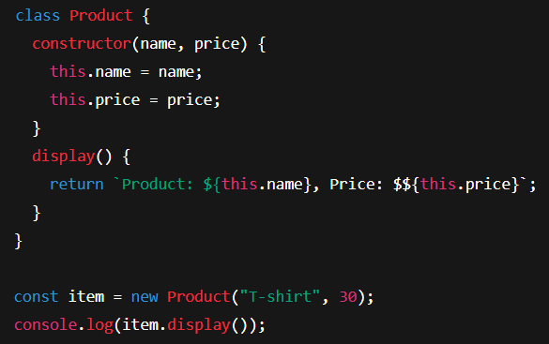
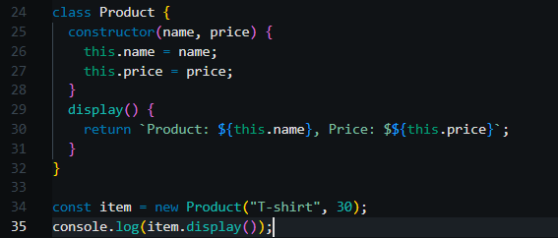
Day 7: Classes - Task
✅ Answer : Classes - Task
Notes:
Syntax is crucial in programming for several reasons:
Clarity and Readability: Syntax provides a structured way to write code, making it easier for programmers to read and understand. Consistent syntax helps convey the intended logic and flow of the program.
Error Reduction: Strict syntax rules help catch errors early in the development process. If the syntax is incorrect, the compiler or interpreter will typically provide feedback, preventing the program from running until the issues are resolved.
Language Definition: Each programming language has its own syntax that defines how code is structured. This syntax is part of what distinguishes one language from another and defines how programmers interact with the language's features.
Tooling and Support: Many development tools, such as IDEs and linters, rely on the syntax of a programming language to provide features like code completion, syntax highlighting, and error detection. Changing the syntax could disrupt these tools' effectiveness.

Slide 21
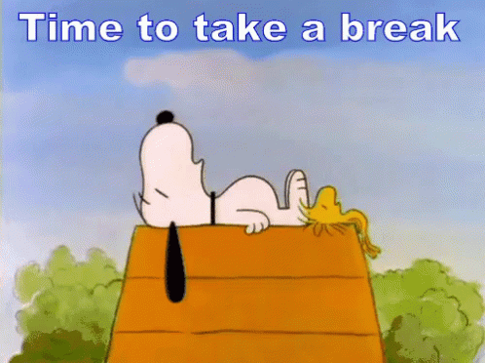
🍵 Break
Notes:
Syntax is crucial in programming for several reasons:
Clarity and Readability: Syntax provides a structured way to write code, making it easier for programmers to read and understand. Consistent syntax helps convey the intended logic and flow of the program.
Error Reduction: Strict syntax rules help catch errors early in the development process. If the syntax is incorrect, the compiler or interpreter will typically provide feedback, preventing the program from running until the issues are resolved.
Language Definition: Each programming language has its own syntax that defines how code is structured. This syntax is part of what distinguishes one language from another and defines how programmers interact with the language's features.
Tooling and Support: Many development tools, such as IDEs and linters, rely on the syntax of a programming language to provide features like code completion, syntax highlighting, and error detection. Changing the syntax could disrupt these tools' effectiveness.

Slide 22
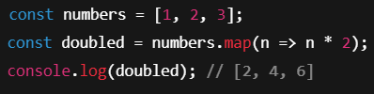
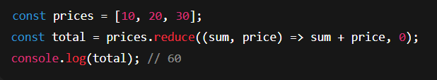
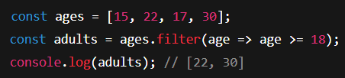
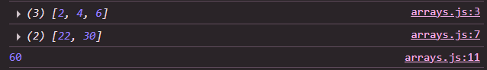
Day 7: Array Methods - map, filter, reduce
المصفوفات من أهم الحاجات في جافاسكريبت، ومع ES6+ بقى عندنا دوال قوية بتسهّل التعامل معاها :
✅ map: بتعمل تعديل لكل عنصر وترجع مصفوفة جديدة
✅ filter: بترجع العناصر اللي بتحقق شرط معين
✅ reduce: بتدمج القيم للحصول على قيمة واحدة (زي المجموع)
Notes:
Syntax is crucial in programming for several reasons:
Clarity and Readability: Syntax provides a structured way to write code, making it easier for programmers to read and understand. Consistent syntax helps convey the intended logic and flow of the program.
Error Reduction: Strict syntax rules help catch errors early in the development process. If the syntax is incorrect, the compiler or interpreter will typically provide feedback, preventing the program from running until the issues are resolved.
Language Definition: Each programming language has its own syntax that defines how code is structured. This syntax is part of what distinguishes one language from another and defines how programmers interact with the language's features.
Tooling and Support: Many development tools, such as IDEs and linters, rely on the syntax of a programming language to provide features like code completion, syntax highlighting, and error detection. Changing the syntax could disrupt these tools' effectiveness.

Slide 23
Day 7: Array Methods - Task
🧠 Array Methods - Task
❓ السؤال:
عندك مصفوفة أرقام:
const numbers = [5, 10, 15, 20];
عايزك تعمل الآتي:
✅ تستخدم map لمضاعفة الأرقام
✅ تستخدمfilter لاستخراج الأرقام الأكبر من 10
✅ تستخدمreduce لحساب مجموع القيم
Notes:
Syntax is crucial in programming for several reasons:
Clarity and Readability: Syntax provides a structured way to write code, making it easier for programmers to read and understand. Consistent syntax helps convey the intended logic and flow of the program.
Error Reduction: Strict syntax rules help catch errors early in the development process. If the syntax is incorrect, the compiler or interpreter will typically provide feedback, preventing the program from running until the issues are resolved.
Language Definition: Each programming language has its own syntax that defines how code is structured. This syntax is part of what distinguishes one language from another and defines how programmers interact with the language's features.
Tooling and Support: Many development tools, such as IDEs and linters, rely on the syntax of a programming language to provide features like code completion, syntax highlighting, and error detection. Changing the syntax could disrupt these tools' effectiveness.

Slide 24
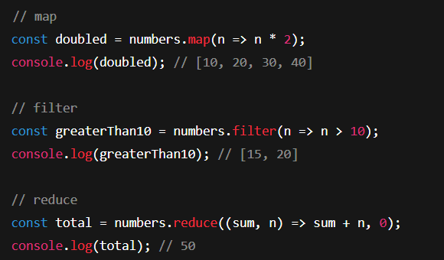
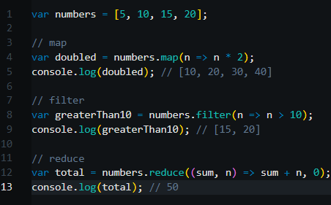
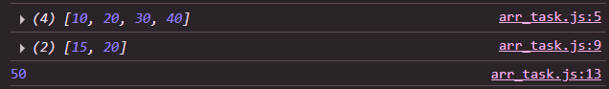
Day 7: Array Methods - Task
✅ Answer : Array Methods - Task
Notes:
Syntax is crucial in programming for several reasons:
Clarity and Readability: Syntax provides a structured way to write code, making it easier for programmers to read and understand. Consistent syntax helps convey the intended logic and flow of the program.
Error Reduction: Strict syntax rules help catch errors early in the development process. If the syntax is incorrect, the compiler or interpreter will typically provide feedback, preventing the program from running until the issues are resolved.
Language Definition: Each programming language has its own syntax that defines how code is structured. This syntax is part of what distinguishes one language from another and defines how programmers interact with the language's features.
Tooling and Support: Many development tools, such as IDEs and linters, rely on the syntax of a programming language to provide features like code completion, syntax highlighting, and error detection. Changing the syntax could disrupt these tools' effectiveness.

Slide 25
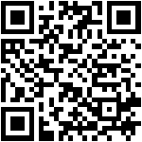
Day 7: Introduction to APIs
الـ API هو اختصار لـ Application Programming Interface، وهو عبارة عن وسيط يسمح للتطبيقات بالتواصل مع بعض. في الجزء ده هنتعامل مع API وهمي اسمه JSONPlaceholder عشان نتمرّن على استهلاك بيانات حقيقية.
الرابط الرئيسي:
https://jsonplaceholder.typicode.com
https://api.qrserver.com/v1/create-qr-code/?size=150x150&data=https://jsonplaceholder.typicode.com
Notes:
Syntax is crucial in programming for several reasons:
Clarity and Readability: Syntax provides a structured way to write code, making it easier for programmers to read and understand. Consistent syntax helps convey the intended logic and flow of the program.
Error Reduction: Strict syntax rules help catch errors early in the development process. If the syntax is incorrect, the compiler or interpreter will typically provide feedback, preventing the program from running until the issues are resolved.
Language Definition: Each programming language has its own syntax that defines how code is structured. This syntax is part of what distinguishes one language from another and defines how programmers interact with the language's features.
Tooling and Support: Many development tools, such as IDEs and linters, rely on the syntax of a programming language to provide features like code completion, syntax highlighting, and error detection. Changing the syntax could disrupt these tools' effectiveness.

Slide 26
Day 7: JSONPlaceholder API - Available Endpoints
موقعJSONPlaceholder بيوفّر بيانات جاهزة للتجارب والتعلّم، منها:
/✅posts – منشورات
/✅comments – تعليقات
/✅albums – ألبومات
/✅photos – صور
/✅to-do’s – مهام
/✅users - بيانات مستخدمين
هنجرب الأمثلة كلها على الموقع ده.
https://api.qrserver.com/v1/create-qr-code/?size=150x150&data=https://jsonplaceholder.typicode.com
Notes:
Syntax is crucial in programming for several reasons:
Clarity and Readability: Syntax provides a structured way to write code, making it easier for programmers to read and understand. Consistent syntax helps convey the intended logic and flow of the program.
Error Reduction: Strict syntax rules help catch errors early in the development process. If the syntax is incorrect, the compiler or interpreter will typically provide feedback, preventing the program from running until the issues are resolved.
Language Definition: Each programming language has its own syntax that defines how code is structured. This syntax is part of what distinguishes one language from another and defines how programmers interact with the language's features.
Tooling and Support: Many development tools, such as IDEs and linters, rely on the syntax of a programming language to provide features like code completion, syntax highlighting, and error detection. Changing the syntax could disrupt these tools' effectiveness.

Slide 27




Day 7: Fetch API - Get Data from JSONPlaceholder
باستخدامFetch API في جافاسكريبت، بنقدر نطلب بيانات من السيرفر ونستخدمها في مشروعنا.
Notes:
Syntax is crucial in programming for several reasons:
Clarity and Readability: Syntax provides a structured way to write code, making it easier for programmers to read and understand. Consistent syntax helps convey the intended logic and flow of the program.
Error Reduction: Strict syntax rules help catch errors early in the development process. If the syntax is incorrect, the compiler or interpreter will typically provide feedback, preventing the program from running until the issues are resolved.
Language Definition: Each programming language has its own syntax that defines how code is structured. This syntax is part of what distinguishes one language from another and defines how programmers interact with the language's features.
Tooling and Support: Many development tools, such as IDEs and linters, rely on the syntax of a programming language to provide features like code completion, syntax highlighting, and error detection. Changing the syntax could disrupt these tools' effectiveness.

Slide 28
Day 7: Fetch API - Task
🧠 Fetch API - Task
❓ السؤال:
عايزك تكتب كود باستخدام Fetch عشان تجيب بيانات أول 5 منشورات من JSONPlaceholder وتطبعهم في الكونسول.
Notes:
Syntax is crucial in programming for several reasons:
Clarity and Readability: Syntax provides a structured way to write code, making it easier for programmers to read and understand. Consistent syntax helps convey the intended logic and flow of the program.
Error Reduction: Strict syntax rules help catch errors early in the development process. If the syntax is incorrect, the compiler or interpreter will typically provide feedback, preventing the program from running until the issues are resolved.
Language Definition: Each programming language has its own syntax that defines how code is structured. This syntax is part of what distinguishes one language from another and defines how programmers interact with the language's features.
Tooling and Support: Many development tools, such as IDEs and linters, rely on the syntax of a programming language to provide features like code completion, syntax highlighting, and error detection. Changing the syntax could disrupt these tools' effectiveness.

Slide 29



Day 7: Fetch API - Solution
✅ Answer : Fetch API - Solution
Notes:
Syntax is crucial in programming for several reasons:
Clarity and Readability: Syntax provides a structured way to write code, making it easier for programmers to read and understand. Consistent syntax helps convey the intended logic and flow of the program.
Error Reduction: Strict syntax rules help catch errors early in the development process. If the syntax is incorrect, the compiler or interpreter will typically provide feedback, preventing the program from running until the issues are resolved.
Language Definition: Each programming language has its own syntax that defines how code is structured. This syntax is part of what distinguishes one language from another and defines how programmers interact with the language's features.
Tooling and Support: Many development tools, such as IDEs and linters, rely on the syntax of a programming language to provide features like code completion, syntax highlighting, and error detection. Changing the syntax could disrupt these tools' effectiveness.

Slide 30

Day 7: Async/Await with JSONPlaceholder
بدل ما نستخدم then و catch بشكل متسلسل، ممكن نستخدم Async/Await عشان الكود يبقى أنضف وأسهل في القراءة، وده بيفيد جدًا مع الـ API.
Notes:
Syntax is crucial in programming for several reasons:
Clarity and Readability: Syntax provides a structured way to write code, making it easier for programmers to read and understand. Consistent syntax helps convey the intended logic and flow of the program.
Error Reduction: Strict syntax rules help catch errors early in the development process. If the syntax is incorrect, the compiler or interpreter will typically provide feedback, preventing the program from running until the issues are resolved.
Language Definition: Each programming language has its own syntax that defines how code is structured. This syntax is part of what distinguishes one language from another and defines how programmers interact with the language's features.
Tooling and Support: Many development tools, such as IDEs and linters, rely on the syntax of a programming language to provide features like code completion, syntax highlighting, and error detection. Changing the syntax could disrupt these tools' effectiveness.

Slide 31


Day 7: Async/Await with JSONPlaceholder
كدا بنتعامل بمرونة اكتر مع الAPI بحيث أيا كان ال API اللي عايزين نجيب منه داتا هنستعمل معاه function ثابته واحدة بس
Notes:
Syntax is crucial in programming for several reasons:
Clarity and Readability: Syntax provides a structured way to write code, making it easier for programmers to read and understand. Consistent syntax helps convey the intended logic and flow of the program.
Error Reduction: Strict syntax rules help catch errors early in the development process. If the syntax is incorrect, the compiler or interpreter will typically provide feedback, preventing the program from running until the issues are resolved.
Language Definition: Each programming language has its own syntax that defines how code is structured. This syntax is part of what distinguishes one language from another and defines how programmers interact with the language's features.
Tooling and Support: Many development tools, such as IDEs and linters, rely on the syntax of a programming language to provide features like code completion, syntax highlighting, and error detection. Changing the syntax could disrupt these tools' effectiveness.

Slide 32


Day 7: Async/Await with JSONPlaceholder
ودي طريقة نطبق بيها نفس المثال بس بال arrow function.
Notes:
Syntax is crucial in programming for several reasons:
Clarity and Readability: Syntax provides a structured way to write code, making it easier for programmers to read and understand. Consistent syntax helps convey the intended logic and flow of the program.
Error Reduction: Strict syntax rules help catch errors early in the development process. If the syntax is incorrect, the compiler or interpreter will typically provide feedback, preventing the program from running until the issues are resolved.
Language Definition: Each programming language has its own syntax that defines how code is structured. This syntax is part of what distinguishes one language from another and defines how programmers interact with the language's features.
Tooling and Support: Many development tools, such as IDEs and linters, rely on the syntax of a programming language to provide features like code completion, syntax highlighting, and error detection. Changing the syntax could disrupt these tools' effectiveness.

Slide 33
Day 7: Async/Await - Task
🧠 Async/Await - Task
❓ السؤال:
عايزك تكتب دالة باستخدامAsync/Await تجيب بيانات مستخدم معينID=1) ) من JSONPlaceholder وتطبع اسمه في الكونسول.
Notes:
Syntax is crucial in programming for several reasons:
Clarity and Readability: Syntax provides a structured way to write code, making it easier for programmers to read and understand. Consistent syntax helps convey the intended logic and flow of the program.
Error Reduction: Strict syntax rules help catch errors early in the development process. If the syntax is incorrect, the compiler or interpreter will typically provide feedback, preventing the program from running until the issues are resolved.
Language Definition: Each programming language has its own syntax that defines how code is structured. This syntax is part of what distinguishes one language from another and defines how programmers interact with the language's features.
Tooling and Support: Many development tools, such as IDEs and linters, rely on the syntax of a programming language to provide features like code completion, syntax highlighting, and error detection. Changing the syntax could disrupt these tools' effectiveness.

Slide 34


Day 7: Async/Await - Task
✅ Answer : Async/Await - Task
الحل دا اقدر اجيب بيه أي بوست من function واحدة ثابتة ودا هيقلل معايا الكود والاسطر ويزود المرونة والسرعة
Notes:
Syntax is crucial in programming for several reasons:
Clarity and Readability: Syntax provides a structured way to write code, making it easier for programmers to read and understand. Consistent syntax helps convey the intended logic and flow of the program.
Error Reduction: Strict syntax rules help catch errors early in the development process. If the syntax is incorrect, the compiler or interpreter will typically provide feedback, preventing the program from running until the issues are resolved.
Language Definition: Each programming language has its own syntax that defines how code is structured. This syntax is part of what distinguishes one language from another and defines how programmers interact with the language's features.
Tooling and Support: Many development tools, such as IDEs and linters, rely on the syntax of a programming language to provide features like code completion, syntax highlighting, and error detection. Changing the syntax could disrupt these tools' effectiveness.

Slide 35

Day 7: Display API Data in HTML
مش بس نطبع البيانات في الكونسول، كمان نقدر نعرضها داخل عناصرHTML باستخدام DOM.
Notes:
Syntax is crucial in programming for several reasons:
Clarity and Readability: Syntax provides a structured way to write code, making it easier for programmers to read and understand. Consistent syntax helps convey the intended logic and flow of the program.
Error Reduction: Strict syntax rules help catch errors early in the development process. If the syntax is incorrect, the compiler or interpreter will typically provide feedback, preventing the program from running until the issues are resolved.
Language Definition: Each programming language has its own syntax that defines how code is structured. This syntax is part of what distinguishes one language from another and defines how programmers interact with the language's features.
Tooling and Support: Many development tools, such as IDEs and linters, rely on the syntax of a programming language to provide features like code completion, syntax highlighting, and error detection. Changing the syntax could disrupt these tools' effectiveness.

Slide 36

Day 7: Display API Data - Task
🧠 Display API Data - Task
❓ السؤال:
عايزك تستخدم نفس الأسلوب لعرض بيانات مستخدم معين داخل عنصر HTML بالشكل التالي:
Notes:
Syntax is crucial in programming for several reasons:
Clarity and Readability: Syntax provides a structured way to write code, making it easier for programmers to read and understand. Consistent syntax helps convey the intended logic and flow of the program.
Error Reduction: Strict syntax rules help catch errors early in the development process. If the syntax is incorrect, the compiler or interpreter will typically provide feedback, preventing the program from running until the issues are resolved.
Language Definition: Each programming language has its own syntax that defines how code is structured. This syntax is part of what distinguishes one language from another and defines how programmers interact with the language's features.
Tooling and Support: Many development tools, such as IDEs and linters, rely on the syntax of a programming language to provide features like code completion, syntax highlighting, and error detection. Changing the syntax could disrupt these tools' effectiveness.

Slide 37


Day 7: Async/Await - Task
✅ Answer : Async/Await - Task
Notes:
Syntax is crucial in programming for several reasons:
Clarity and Readability: Syntax provides a structured way to write code, making it easier for programmers to read and understand. Consistent syntax helps convey the intended logic and flow of the program.
Error Reduction: Strict syntax rules help catch errors early in the development process. If the syntax is incorrect, the compiler or interpreter will typically provide feedback, preventing the program from running until the issues are resolved.
Language Definition: Each programming language has its own syntax that defines how code is structured. This syntax is part of what distinguishes one language from another and defines how programmers interact with the language's features.
Tooling and Support: Many development tools, such as IDEs and linters, rely on the syntax of a programming language to provide features like code completion, syntax highlighting, and error detection. Changing the syntax could disrupt these tools' effectiveness.

Slide 38
🍵 Break
Notes:
Syntax is crucial in programming for several reasons:
Clarity and Readability: Syntax provides a structured way to write code, making it easier for programmers to read and understand. Consistent syntax helps convey the intended logic and flow of the program.
Error Reduction: Strict syntax rules help catch errors early in the development process. If the syntax is incorrect, the compiler or interpreter will typically provide feedback, preventing the program from running until the issues are resolved.
Language Definition: Each programming language has its own syntax that defines how code is structured. This syntax is part of what distinguishes one language from another and defines how programmers interact with the language's features.
Tooling and Support: Many development tools, such as IDEs and linters, rely on the syntax of a programming language to provide features like code completion, syntax highlighting, and error detection. Changing the syntax could disrupt these tools' effectiveness.

Slide 39


Day 7: Error Handling with Fetch API
لما تتعامل مع API، لازم تتوقع إن في أي وقت ممكن يحصل أخطاء، سواء في الاتصال أو في البيانات، عشان كده لازم نستخدم try/catch ونتأكد من حالة الاستجابة.
Notes:
Syntax is crucial in programming for several reasons:
Clarity and Readability: Syntax provides a structured way to write code, making it easier for programmers to read and understand. Consistent syntax helps convey the intended logic and flow of the program.
Error Reduction: Strict syntax rules help catch errors early in the development process. If the syntax is incorrect, the compiler or interpreter will typically provide feedback, preventing the program from running until the issues are resolved.
Language Definition: Each programming language has its own syntax that defines how code is structured. This syntax is part of what distinguishes one language from another and defines how programmers interact with the language's features.
Tooling and Support: Many development tools, such as IDEs and linters, rely on the syntax of a programming language to provide features like code completion, syntax highlighting, and error detection. Changing the syntax could disrupt these tools' effectiveness.

Slide 40
Day 7: Error Handling - Task
🧠 Error Handling - Task
❓ السؤال:
اكتب دالة باستخدام Async/Await تجيب بيانات من / users/1000وتتعامل مع الحالة لو المستخدم مش موجود، وتطبع رسالة واضحة في الكونسول.
Notes:
Syntax is crucial in programming for several reasons:
Clarity and Readability: Syntax provides a structured way to write code, making it easier for programmers to read and understand. Consistent syntax helps convey the intended logic and flow of the program.
Error Reduction: Strict syntax rules help catch errors early in the development process. If the syntax is incorrect, the compiler or interpreter will typically provide feedback, preventing the program from running until the issues are resolved.
Language Definition: Each programming language has its own syntax that defines how code is structured. This syntax is part of what distinguishes one language from another and defines how programmers interact with the language's features.
Tooling and Support: Many development tools, such as IDEs and linters, rely on the syntax of a programming language to provide features like code completion, syntax highlighting, and error detection. Changing the syntax could disrupt these tools' effectiveness.

Slide 41

Day 7: Error Handling - Solution
✅ Answer : Error Handling - Solution
Notes:
Syntax is crucial in programming for several reasons:
Clarity and Readability: Syntax provides a structured way to write code, making it easier for programmers to read and understand. Consistent syntax helps convey the intended logic and flow of the program.
Error Reduction: Strict syntax rules help catch errors early in the development process. If the syntax is incorrect, the compiler or interpreter will typically provide feedback, preventing the program from running until the issues are resolved.
Language Definition: Each programming language has its own syntax that defines how code is structured. This syntax is part of what distinguishes one language from another and defines how programmers interact with the language's features.
Tooling and Support: Many development tools, such as IDEs and linters, rely on the syntax of a programming language to provide features like code completion, syntax highlighting, and error detection. Changing the syntax could disrupt these tools' effectiveness.

Slide 42
Day 7: API Recap & Best Practices
أهم النقاط اللي لازم تفتكرها لما تشتغل مع أي API:
✅ تأكد من الرابط والـ endpoint
✅ استخدمAsync/Await لتسهيل الكود
✅ دايمًا حط try/catch لعلاج الأخطاء
✅ تحقق من حالة الاستجابة response.ok))
✅ لما البيانات تيجي، نظّمها كويس في الواجهة
Notes:
Syntax is crucial in programming for several reasons:
Clarity and Readability: Syntax provides a structured way to write code, making it easier for programmers to read and understand. Consistent syntax helps convey the intended logic and flow of the program.
Error Reduction: Strict syntax rules help catch errors early in the development process. If the syntax is incorrect, the compiler or interpreter will typically provide feedback, preventing the program from running until the issues are resolved.
Language Definition: Each programming language has its own syntax that defines how code is structured. This syntax is part of what distinguishes one language from another and defines how programmers interact with the language's features.
Tooling and Support: Many development tools, such as IDEs and linters, rely on the syntax of a programming language to provide features like code completion, syntax highlighting, and error detection. Changing the syntax could disrupt these tools' effectiveness.

Slide 43
Day 7: Practical Lab - Complete API Integration
في الجزء العملي ده، هنطبّق كل اللي اتعلمناه:
✅جلب بيانات من JSONPlaceholder
✅عرضها في الصفحة
✅التعامل مع الأخطاء
✅كتابة الكود بأسلوب نظيف ومنظّم
Notes:
Syntax is crucial in programming for several reasons:
Clarity and Readability: Syntax provides a structured way to write code, making it easier for programmers to read and understand. Consistent syntax helps convey the intended logic and flow of the program.
Error Reduction: Strict syntax rules help catch errors early in the development process. If the syntax is incorrect, the compiler or interpreter will typically provide feedback, preventing the program from running until the issues are resolved.
Language Definition: Each programming language has its own syntax that defines how code is structured. This syntax is part of what distinguishes one language from another and defines how programmers interact with the language's features.
Tooling and Support: Many development tools, such as IDEs and linters, rely on the syntax of a programming language to provide features like code completion, syntax highlighting, and error detection. Changing the syntax could disrupt these tools' effectiveness.

Slide 44
Day 7: Practical Lab - Complete API Integration
🧠 Practical Lab - Complete API Integration
❓ السؤال:
عايزك تعمل صفحة تعرض قائمة مهامTo-Do List) ) جايه من:
https://jsonplaceholder.typicode.com/todos?_limit=5
لكل مهمة، يظهر:
العنوان
الحالة (مكتملة أو لا)
Notes:
Syntax is crucial in programming for several reasons:
Clarity and Readability: Syntax provides a structured way to write code, making it easier for programmers to read and understand. Consistent syntax helps convey the intended logic and flow of the program.
Error Reduction: Strict syntax rules help catch errors early in the development process. If the syntax is incorrect, the compiler or interpreter will typically provide feedback, preventing the program from running until the issues are resolved.
Language Definition: Each programming language has its own syntax that defines how code is structured. This syntax is part of what distinguishes one language from another and defines how programmers interact with the language's features.
Tooling and Support: Many development tools, such as IDEs and linters, rely on the syntax of a programming language to provide features like code completion, syntax highlighting, and error detection. Changing the syntax could disrupt these tools' effectiveness.

Slide 45


Day 7: Practical Lab - Suggested Solution
✅ Answer : Practical Lab - Suggested Solution
Notes:
Syntax is crucial in programming for several reasons:
Clarity and Readability: Syntax provides a structured way to write code, making it easier for programmers to read and understand. Consistent syntax helps convey the intended logic and flow of the program.
Error Reduction: Strict syntax rules help catch errors early in the development process. If the syntax is incorrect, the compiler or interpreter will typically provide feedback, preventing the program from running until the issues are resolved.
Language Definition: Each programming language has its own syntax that defines how code is structured. This syntax is part of what distinguishes one language from another and defines how programmers interact with the language's features.
Tooling and Support: Many development tools, such as IDEs and linters, rely on the syntax of a programming language to provide features like code completion, syntax highlighting, and error detection. Changing the syntax could disrupt these tools' effectiveness.

Slide 46

🍜 Lunch
Notes:
Syntax is crucial in programming for several reasons:
Clarity and Readability: Syntax provides a structured way to write code, making it easier for programmers to read and understand. Consistent syntax helps convey the intended logic and flow of the program.
Error Reduction: Strict syntax rules help catch errors early in the development process. If the syntax is incorrect, the compiler or interpreter will typically provide feedback, preventing the program from running until the issues are resolved.
Language Definition: Each programming language has its own syntax that defines how code is structured. This syntax is part of what distinguishes one language from another and defines how programmers interact with the language's features.
Tooling and Support: Many development tools, such as IDEs and linters, rely on the syntax of a programming language to provide features like code completion, syntax highlighting, and error detection. Changing the syntax could disrupt these tools' effectiveness.

Slide 47
Day 7: Advanced Array Methods Recap
راجع معايا بسرعة أهم دوال التعامل مع المصفوفات اللي هتستخدمها يوميًا:
✅map: لإنشاء مصفوفة جديدة بناءً على تعديل القيم
✅filter: لاستخراج عناصر بتحقق شرط
✅reduce: لدمج عناصر المصفوفة لقيمة واحدة
✅find: بترجع أول عنصر يحقق الشرط
✅some: بتتحقق إذا كان فيه على الأقل عنصر يحقق الشرط
✅every: بتتحقق إذا كل العناصر بتحقق الشرط
Notes:
Syntax is crucial in programming for several reasons:
Clarity and Readability: Syntax provides a structured way to write code, making it easier for programmers to read and understand. Consistent syntax helps convey the intended logic and flow of the program.
Error Reduction: Strict syntax rules help catch errors early in the development process. If the syntax is incorrect, the compiler or interpreter will typically provide feedback, preventing the program from running until the issues are resolved.
Language Definition: Each programming language has its own syntax that defines how code is structured. This syntax is part of what distinguishes one language from another and defines how programmers interact with the language's features.
Tooling and Support: Many development tools, such as IDEs and linters, rely on the syntax of a programming language to provide features like code completion, syntax highlighting, and error detection. Changing the syntax could disrupt these tools' effectiveness.

Slide 48




Day 7: Advanced Array Methods - Examples
Notes:
Syntax is crucial in programming for several reasons:
Clarity and Readability: Syntax provides a structured way to write code, making it easier for programmers to read and understand. Consistent syntax helps convey the intended logic and flow of the program.
Error Reduction: Strict syntax rules help catch errors early in the development process. If the syntax is incorrect, the compiler or interpreter will typically provide feedback, preventing the program from running until the issues are resolved.
Language Definition: Each programming language has its own syntax that defines how code is structured. This syntax is part of what distinguishes one language from another and defines how programmers interact with the language's features.
Tooling and Support: Many development tools, such as IDEs and linters, rely on the syntax of a programming language to provide features like code completion, syntax highlighting, and error detection. Changing the syntax could disrupt these tools' effectiveness.

Slide 49

Day 7: Advanced Array Methods - Examples
Notes:
Syntax is crucial in programming for several reasons:
Clarity and Readability: Syntax provides a structured way to write code, making it easier for programmers to read and understand. Consistent syntax helps convey the intended logic and flow of the program.
Error Reduction: Strict syntax rules help catch errors early in the development process. If the syntax is incorrect, the compiler or interpreter will typically provide feedback, preventing the program from running until the issues are resolved.
Language Definition: Each programming language has its own syntax that defines how code is structured. This syntax is part of what distinguishes one language from another and defines how programmers interact with the language's features.
Tooling and Support: Many development tools, such as IDEs and linters, rely on the syntax of a programming language to provide features like code completion, syntax highlighting, and error detection. Changing the syntax could disrupt these tools' effectiveness.

Slide 50

Day 7: Advanced Array Methods - Task
🧠 Advanced Array Methods - Task
❓ السؤال:
عندك المصفوفة دي:
عايزك تعمل الآتي:
✅ تستخدم find لإيجاد أول مهمة مكتملة
✅ تستخدمsome للتحقق إذا فيه أي مهمة غير مكتملة
✅ تستخدمevery للتحقق إذا كل المهام مكتملة
Notes:
Syntax is crucial in programming for several reasons:
Clarity and Readability: Syntax provides a structured way to write code, making it easier for programmers to read and understand. Consistent syntax helps convey the intended logic and flow of the program.
Error Reduction: Strict syntax rules help catch errors early in the development process. If the syntax is incorrect, the compiler or interpreter will typically provide feedback, preventing the program from running until the issues are resolved.
Language Definition: Each programming language has its own syntax that defines how code is structured. This syntax is part of what distinguishes one language from another and defines how programmers interact with the language's features.
Tooling and Support: Many development tools, such as IDEs and linters, rely on the syntax of a programming language to provide features like code completion, syntax highlighting, and error detection. Changing the syntax could disrupt these tools' effectiveness.

Slide 51



Day 7: Advanced Array Methods - Solution
✅ Answer : Advanced Array Methods - Solution
Notes:
Syntax is crucial in programming for several reasons:
Clarity and Readability: Syntax provides a structured way to write code, making it easier for programmers to read and understand. Consistent syntax helps convey the intended logic and flow of the program.
Error Reduction: Strict syntax rules help catch errors early in the development process. If the syntax is incorrect, the compiler or interpreter will typically provide feedback, preventing the program from running until the issues are resolved.
Language Definition: Each programming language has its own syntax that defines how code is structured. This syntax is part of what distinguishes one language from another and defines how programmers interact with the language's features.
Tooling and Support: Many development tools, such as IDEs and linters, rely on the syntax of a programming language to provide features like code completion, syntax highlighting, and error detection. Changing the syntax could disrupt these tools' effectiveness.

Slide 52

Day 7: Advanced Array Methods - Solution
✅ Answer : Advanced Array Methods - Solution
Notes:
Syntax is crucial in programming for several reasons:
Clarity and Readability: Syntax provides a structured way to write code, making it easier for programmers to read and understand. Consistent syntax helps convey the intended logic and flow of the program.
Error Reduction: Strict syntax rules help catch errors early in the development process. If the syntax is incorrect, the compiler or interpreter will typically provide feedback, preventing the program from running until the issues are resolved.
Language Definition: Each programming language has its own syntax that defines how code is structured. This syntax is part of what distinguishes one language from another and defines how programmers interact with the language's features.
Tooling and Support: Many development tools, such as IDEs and linters, rely on the syntax of a programming language to provide features like code completion, syntax highlighting, and error detection. Changing the syntax could disrupt these tools' effectiveness.

Slide 53
Day 7: Project Structure - Shopping Cart
في المشاريع الواقعية، لازم يكون عندك تنظيم للكود، عشان تعرف تتحكم في الخصائص والعمليات.
هنا هنبني سلة تسوّق بسيطة باستخدام:
✅Class لتنظيم العناصر
✅LocalStorage لحفظ البيانات
✅دوال حساب الإجمالي والخصم
Notes:
Syntax is crucial in programming for several reasons:
Clarity and Readability: Syntax provides a structured way to write code, making it easier for programmers to read and understand. Consistent syntax helps convey the intended logic and flow of the program.
Error Reduction: Strict syntax rules help catch errors early in the development process. If the syntax is incorrect, the compiler or interpreter will typically provide feedback, preventing the program from running until the issues are resolved.
Language Definition: Each programming language has its own syntax that defines how code is structured. This syntax is part of what distinguishes one language from another and defines how programmers interact with the language's features.
Tooling and Support: Many development tools, such as IDEs and linters, rely on the syntax of a programming language to provide features like code completion, syntax highlighting, and error detection. Changing the syntax could disrupt these tools' effectiveness.

Slide 54


Day 7: Shopping Cart - Class Example
Notes:
Syntax is crucial in programming for several reasons:
Clarity and Readability: Syntax provides a structured way to write code, making it easier for programmers to read and understand. Consistent syntax helps convey the intended logic and flow of the program.
Error Reduction: Strict syntax rules help catch errors early in the development process. If the syntax is incorrect, the compiler or interpreter will typically provide feedback, preventing the program from running until the issues are resolved.
Language Definition: Each programming language has its own syntax that defines how code is structured. This syntax is part of what distinguishes one language from another and defines how programmers interact with the language's features.
Tooling and Support: Many development tools, such as IDEs and linters, rely on the syntax of a programming language to provide features like code completion, syntax highlighting, and error detection. Changing the syntax could disrupt these tools' effectiveness.

Slide 55
Day 7: Advanced Array Methods - Task
🧠 Advanced Array Methods - Task
❓ السؤال:
عايزك تكمل الكلاس بإضافة دالة:
✅removeItem: تقدر تمسح عنصر حسب الـ id
✅clearCart: تفرّغ السلة بالكامل
Notes:
Syntax is crucial in programming for several reasons:
Clarity and Readability: Syntax provides a structured way to write code, making it easier for programmers to read and understand. Consistent syntax helps convey the intended logic and flow of the program.
Error Reduction: Strict syntax rules help catch errors early in the development process. If the syntax is incorrect, the compiler or interpreter will typically provide feedback, preventing the program from running until the issues are resolved.
Language Definition: Each programming language has its own syntax that defines how code is structured. This syntax is part of what distinguishes one language from another and defines how programmers interact with the language's features.
Tooling and Support: Many development tools, such as IDEs and linters, rely on the syntax of a programming language to provide features like code completion, syntax highlighting, and error detection. Changing the syntax could disrupt these tools' effectiveness.

Slide 56



Day 7: Shopping Cart - Solution
✅ Answer : Shopping Cart - Solution
Notes:
Syntax is crucial in programming for several reasons:
Clarity and Readability: Syntax provides a structured way to write code, making it easier for programmers to read and understand. Consistent syntax helps convey the intended logic and flow of the program.
Error Reduction: Strict syntax rules help catch errors early in the development process. If the syntax is incorrect, the compiler or interpreter will typically provide feedback, preventing the program from running until the issues are resolved.
Language Definition: Each programming language has its own syntax that defines how code is structured. This syntax is part of what distinguishes one language from another and defines how programmers interact with the language's features.
Tooling and Support: Many development tools, such as IDEs and linters, rely on the syntax of a programming language to provide features like code completion, syntax highlighting, and error detection. Changing the syntax could disrupt these tools' effectiveness.

Slide 57



Day 7: Shopping Cart - Total with Discount
عايزين نحسّن الكلاس بإضافة خصم تلقائي لو فيه 3 عناصر أو أكتر.
Notes:
Syntax is crucial in programming for several reasons:
Clarity and Readability: Syntax provides a structured way to write code, making it easier for programmers to read and understand. Consistent syntax helps convey the intended logic and flow of the program.
Error Reduction: Strict syntax rules help catch errors early in the development process. If the syntax is incorrect, the compiler or interpreter will typically provide feedback, preventing the program from running until the issues are resolved.
Language Definition: Each programming language has its own syntax that defines how code is structured. This syntax is part of what distinguishes one language from another and defines how programmers interact with the language's features.
Tooling and Support: Many development tools, such as IDEs and linters, rely on the syntax of a programming language to provide features like code completion, syntax highlighting, and error detection. Changing the syntax could disrupt these tools' effectiveness.

Slide 58
Day 7: Shopping Cart - Task
🧠 Shopping Cart - Task
❓ السؤال:
جرّب الكلاس بإضافة 3 عناصر:
✅ اسم المنتج
✅ السعر
✅ ID
بعدها اطبع الإجمالي وشوف الخصم اتطبق ولا لا.
Notes:
Syntax is crucial in programming for several reasons:
Clarity and Readability: Syntax provides a structured way to write code, making it easier for programmers to read and understand. Consistent syntax helps convey the intended logic and flow of the program.
Error Reduction: Strict syntax rules help catch errors early in the development process. If the syntax is incorrect, the compiler or interpreter will typically provide feedback, preventing the program from running until the issues are resolved.
Language Definition: Each programming language has its own syntax that defines how code is structured. This syntax is part of what distinguishes one language from another and defines how programmers interact with the language's features.
Tooling and Support: Many development tools, such as IDEs and linters, rely on the syntax of a programming language to provide features like code completion, syntax highlighting, and error detection. Changing the syntax could disrupt these tools' effectiveness.

Slide 59


Day 7: Shopping Cart - Solution
✅ Answer : Shopping Cart - Solution
Notes:
Syntax is crucial in programming for several reasons:
Clarity and Readability: Syntax provides a structured way to write code, making it easier for programmers to read and understand. Consistent syntax helps convey the intended logic and flow of the program.
Error Reduction: Strict syntax rules help catch errors early in the development process. If the syntax is incorrect, the compiler or interpreter will typically provide feedback, preventing the program from running until the issues are resolved.
Language Definition: Each programming language has its own syntax that defines how code is structured. This syntax is part of what distinguishes one language from another and defines how programmers interact with the language's features.
Tooling and Support: Many development tools, such as IDEs and linters, rely on the syntax of a programming language to provide features like code completion, syntax highlighting, and error detection. Changing the syntax could disrupt these tools' effectiveness.

Slide 60
Day 7: Debugging Common Mistakes
كلنا بنقع في أخطاء برمجية، الأهم هو نعرف إزاي نكتشفها ونصلّحها بسرعة.
أمثلة شائعة:
❌ لوب شغال بعد نهاية المصفوفة
❌ نسيان استخدام
return❌ استدعاء دالة مش موجودة
❌ مشاكل في التعامل مع LocalStorage
Notes:
Syntax is crucial in programming for several reasons:
Clarity and Readability: Syntax provides a structured way to write code, making it easier for programmers to read and understand. Consistent syntax helps convey the intended logic and flow of the program.
Error Reduction: Strict syntax rules help catch errors early in the development process. If the syntax is incorrect, the compiler or interpreter will typically provide feedback, preventing the program from running until the issues are resolved.
Language Definition: Each programming language has its own syntax that defines how code is structured. This syntax is part of what distinguishes one language from another and defines how programmers interact with the language's features.
Tooling and Support: Many development tools, such as IDEs and linters, rely on the syntax of a programming language to provide features like code completion, syntax highlighting, and error detection. Changing the syntax could disrupt these tools' effectiveness.

Slide 61

Day 7: Debugging - Buggy Cart Example
المشكلة:
✅ استخدمنا <= بدل < في اللوب، ده بيدخلنا على عنصرundefined وبالتالي بيطلع خطأ.
Notes:
Syntax is crucial in programming for several reasons:
Clarity and Readability: Syntax provides a structured way to write code, making it easier for programmers to read and understand. Consistent syntax helps convey the intended logic and flow of the program.
Error Reduction: Strict syntax rules help catch errors early in the development process. If the syntax is incorrect, the compiler or interpreter will typically provide feedback, preventing the program from running until the issues are resolved.
Language Definition: Each programming language has its own syntax that defines how code is structured. This syntax is part of what distinguishes one language from another and defines how programmers interact with the language's features.
Tooling and Support: Many development tools, such as IDEs and linters, rely on the syntax of a programming language to provide features like code completion, syntax highlighting, and error detection. Changing the syntax could disrupt these tools' effectiveness.

Slide 62
Day 7: Clean Code & Best Practices
أفضل الممارسات اللي لازم تتعود عليها:
✅ كود بسيط وواضح
✅ الأسماء معبرة وواضحة
✅ دوال صغيرة بتركز على مهمة واحدة
✅ علاج الأخطاء دايمًا
✅ استخدم LocalStorage أو حلول تخزين منظمة
✅ اختبر الكود جزء جزء
Notes:
Syntax is crucial in programming for several reasons:
Clarity and Readability: Syntax provides a structured way to write code, making it easier for programmers to read and understand. Consistent syntax helps convey the intended logic and flow of the program.
Error Reduction: Strict syntax rules help catch errors early in the development process. If the syntax is incorrect, the compiler or interpreter will typically provide feedback, preventing the program from running until the issues are resolved.
Language Definition: Each programming language has its own syntax that defines how code is structured. This syntax is part of what distinguishes one language from another and defines how programmers interact with the language's features.
Tooling and Support: Many development tools, such as IDEs and linters, rely on the syntax of a programming language to provide features like code completion, syntax highlighting, and error detection. Changing the syntax could disrupt these tools' effectiveness.

Slide 63
🍵 Break
Notes:
Syntax is crucial in programming for several reasons:
Clarity and Readability: Syntax provides a structured way to write code, making it easier for programmers to read and understand. Consistent syntax helps convey the intended logic and flow of the program.
Error Reduction: Strict syntax rules help catch errors early in the development process. If the syntax is incorrect, the compiler or interpreter will typically provide feedback, preventing the program from running until the issues are resolved.
Language Definition: Each programming language has its own syntax that defines how code is structured. This syntax is part of what distinguishes one language from another and defines how programmers interact with the language's features.
Tooling and Support: Many development tools, such as IDEs and linters, rely on the syntax of a programming language to provide features like code completion, syntax highlighting, and error detection. Changing the syntax could disrupt these tools' effectiveness.

Slide 64


"Day 4: Lab – Full UI with Form, Priority, Date"
“Let’s now build a real-world UI—tasks with priority, due date, and full form submission.”
Notes:
Syntax is crucial in programming for several reasons:
Clarity and Readability: Syntax provides a structured way to write code, making it easier for programmers to read and understand. Consistent syntax helps convey the intended logic and flow of the program.
Error Reduction: Strict syntax rules help catch errors early in the development process. If the syntax is incorrect, the compiler or interpreter will typically provide feedback, preventing the program from running until the issues are resolved.
Language Definition: Each programming language has its own syntax that defines how code is structured. This syntax is part of what distinguishes one language from another and defines how programmers interact with the language's features.
Tooling and Support: Many development tools, such as IDEs and linters, rely on the syntax of a programming language to provide features like code completion, syntax highlighting, and error detection. Changing the syntax could disrupt these tools' effectiveness.

Slide 65

"Day 4: Common Mistakes"
“Even pros make mistakes. Let’s look at common bugs and how to avoid them.”
Notes:
Syntax is crucial in programming for several reasons:
Clarity and Readability: Syntax provides a structured way to write code, making it easier for programmers to read and understand. Consistent syntax helps convey the intended logic and flow of the program.
Error Reduction: Strict syntax rules help catch errors early in the development process. If the syntax is incorrect, the compiler or interpreter will typically provide feedback, preventing the program from running until the issues are resolved.
Language Definition: Each programming language has its own syntax that defines how code is structured. This syntax is part of what distinguishes one language from another and defines how programmers interact with the language's features.
Tooling and Support: Many development tools, such as IDEs and linters, rely on the syntax of a programming language to provide features like code completion, syntax highlighting, and error detection. Changing the syntax could disrupt these tools' effectiveness.

Slide 66


"Day 4: Mini Project + Stats + Search"
“Wrap-up challenge: add search, task stats, sorting. This will prepare you for real-world apps.”
Notes:
Syntax is crucial in programming for several reasons:
Clarity and Readability: Syntax provides a structured way to write code, making it easier for programmers to read and understand. Consistent syntax helps convey the intended logic and flow of the program.
Error Reduction: Strict syntax rules help catch errors early in the development process. If the syntax is incorrect, the compiler or interpreter will typically provide feedback, preventing the program from running until the issues are resolved.
Language Definition: Each programming language has its own syntax that defines how code is structured. This syntax is part of what distinguishes one language from another and defines how programmers interact with the language's features.
Tooling and Support: Many development tools, such as IDEs and linters, rely on the syntax of a programming language to provide features like code completion, syntax highlighting, and error detection. Changing the syntax could disrupt these tools' effectiveness.

Slide 67

"Day 4: 🧾 Slide 10: Summary Slide – What We Learned "
✅ التعامل مع DOM
📦 استخدام المصفوفات Array
🔁 تكرار البيانات باستخدام Loops
💾 تخزين البيانات في localStorage
🛠️ إنشاء CRUD Task App
🔍 بحث وتصفية وعرض المهام بشكل واقعي
Notes:
Syntax is crucial in programming for several reasons:
Clarity and Readability: Syntax provides a structured way to write code, making it easier for programmers to read and understand. Consistent syntax helps convey the intended logic and flow of the program.
Error Reduction: Strict syntax rules help catch errors early in the development process. If the syntax is incorrect, the compiler or interpreter will typically provide feedback, preventing the program from running until the issues are resolved.
Language Definition: Each programming language has its own syntax that defines how code is structured. This syntax is part of what distinguishes one language from another and defines how programmers interact with the language's features.
Tooling and Support: Many development tools, such as IDEs and linters, rely on the syntax of a programming language to provide features like code completion, syntax highlighting, and error detection. Changing the syntax could disrupt these tools' effectiveness.

Slide 68
"Day 7: 🎯 Key Takeaways"
📂 Project Files
day7/
├── index.html
├── js/
│ ├── api/ # API modules
│ │ ├── cart.js # Shopping cart API
│ │ └── products.js
│ ├── lib/ # Utilities
│ └── main.js # App entry
└── README.md
Notes:
Syntax is crucial in programming for several reasons:
Clarity and Readability: Syntax provides a structured way to write code, making it easier for programmers to read and understand. Consistent syntax helps convey the intended logic and flow of the program.
Error Reduction: Strict syntax rules help catch errors early in the development process. If the syntax is incorrect, the compiler or interpreter will typically provide feedback, preventing the program from running until the issues are resolved.
Language Definition: Each programming language has its own syntax that defines how code is structured. This syntax is part of what distinguishes one language from another and defines how programmers interact with the language's features.
Tooling and Support: Many development tools, such as IDEs and linters, rely on the syntax of a programming language to provide features like code completion, syntax highlighting, and error detection. Changing the syntax could disrupt these tools' effectiveness.

Slide 69


The End
in the end I hope you understood all I said contact on :
https://www.facebook.com/abobakr143
https://wa.me/201113284597

